Slide 1
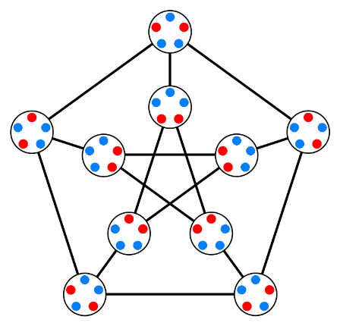
Generalized Counting: Permutation and Combination
Maryiam Zahoor
Email: Maryiam.Zahoor@ucp.edu.pk
Office :
104, C block, behind gym
Office hours:
Monday 2:00- 3:00
Tuesday 1:00 - 2:00
Thursday 2:00 – 3:00
Friday 2:00 - 3:00

Slide 2
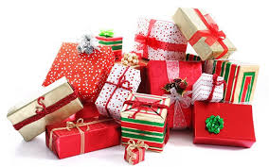
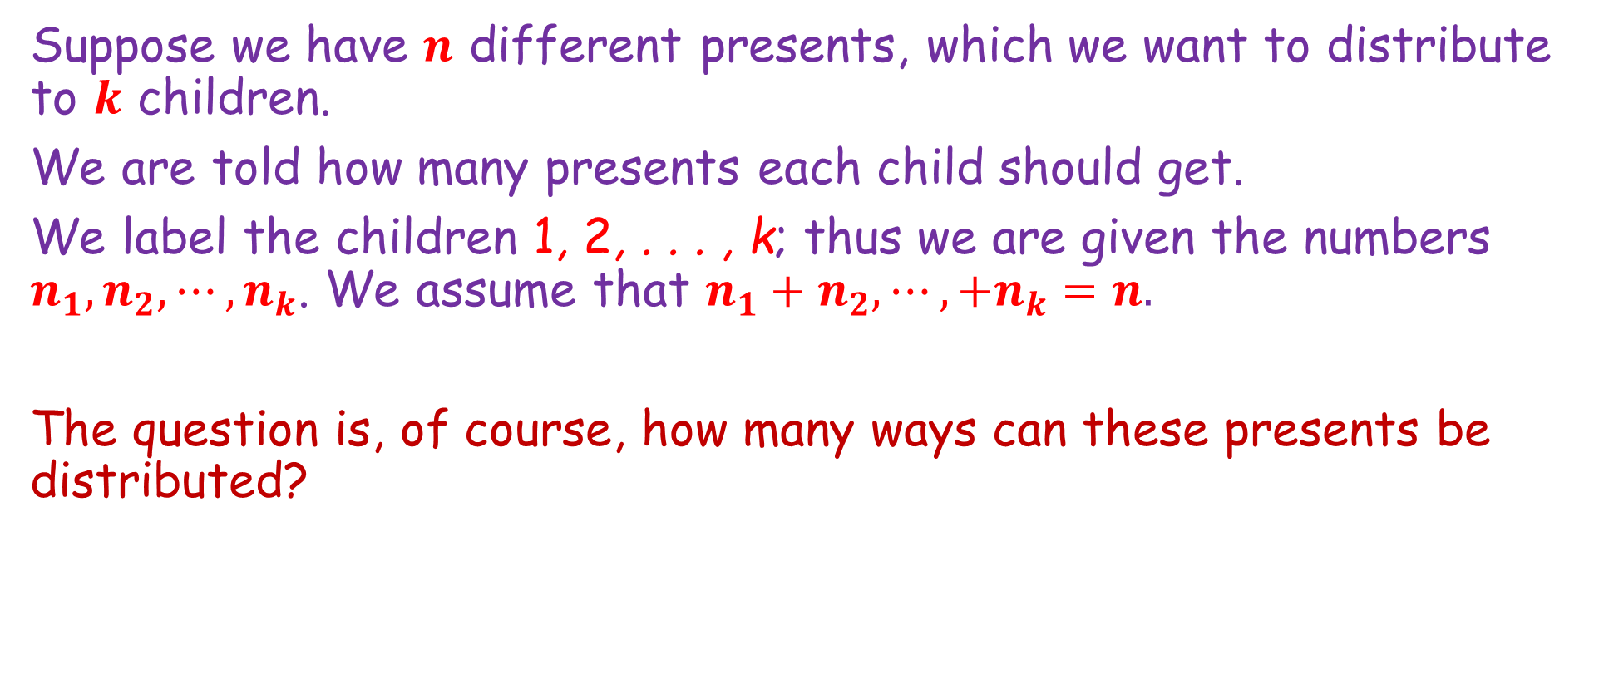
Distributing Gifts (Section 3.2 of textbook)
Suppose we have $n$ different presents, which we want to distribute to $k$ children.
We are told how many presents each child should get.
We label the children 1, 2, . . . , k; thus we are given the numbers $n_{1}, n_{2}, ⋯, n_{k}$. We assume that $n_{1}+n_{2}, ⋯,+n_{k}=n.$
The question is, of course, how many ways can these presents be distributed?

Slide 3


Distributing Presents (Section 3.2 of textbook)
The question is, of course, how many ways can these presents be distributed?
Organize the presents in a line …. How many ways to arrange these $n$ gifts in a line?

Slide 4
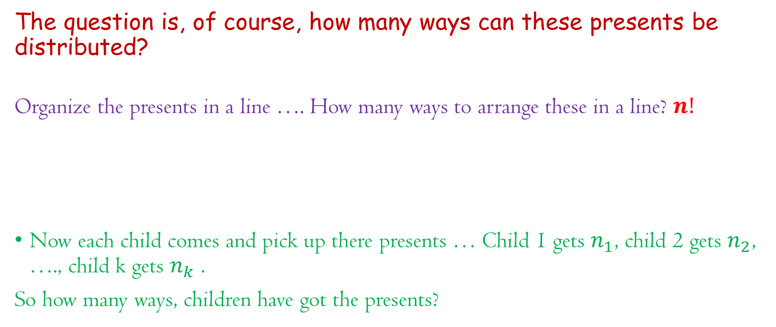
Distributing Presents (Section 3.2 of textbook)
The question is, of course, how many ways can these presents be distributed?
Organize the presents in a line …. How many ways to arrange these in a line? $n!$
Now each child comes and pick up there presents … Child 1 gets $n_{1}$, child 2 gets $n_{2}$, …., child k gets $n_{k}$ .
So how many ways, children have got the presents?

Slide 5
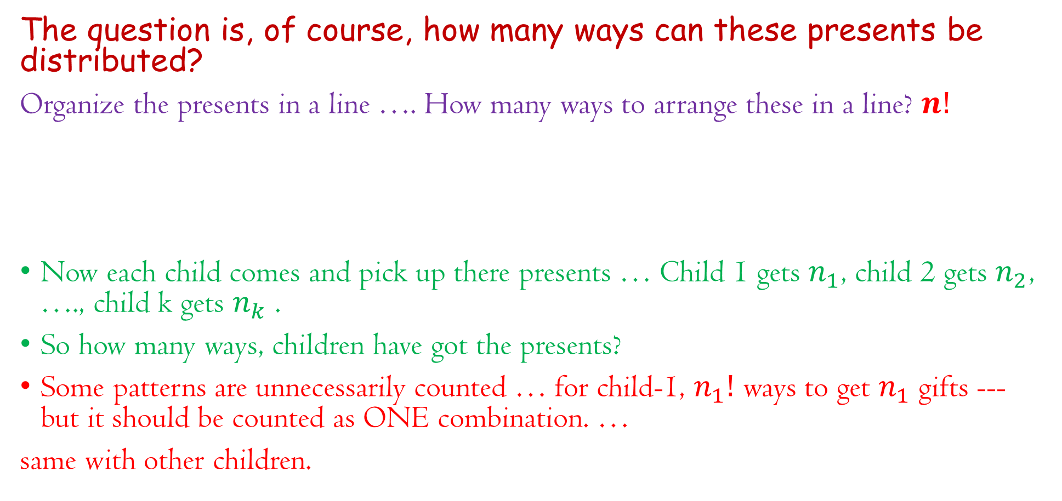
Distributing Presents (Section 3.2 of textbook)
The question is, of course, how many ways can these presents be distributed?
Organize the presents in a line …. How many ways to arrange these in a line? $n!$
Now each child comes and pick up there presents … Child 1 gets $n_{1}$, child 2 gets $n_{2}$, …., child k gets $n_{k}$ .
So how many ways, children have got the presents?
Some patterns are unnecessarily counted … for child-1, $n_{1}!$ ways to get $n_{1}$ gifts --- but it should be counted as ONE combination. …
same with other children.

Slide 6
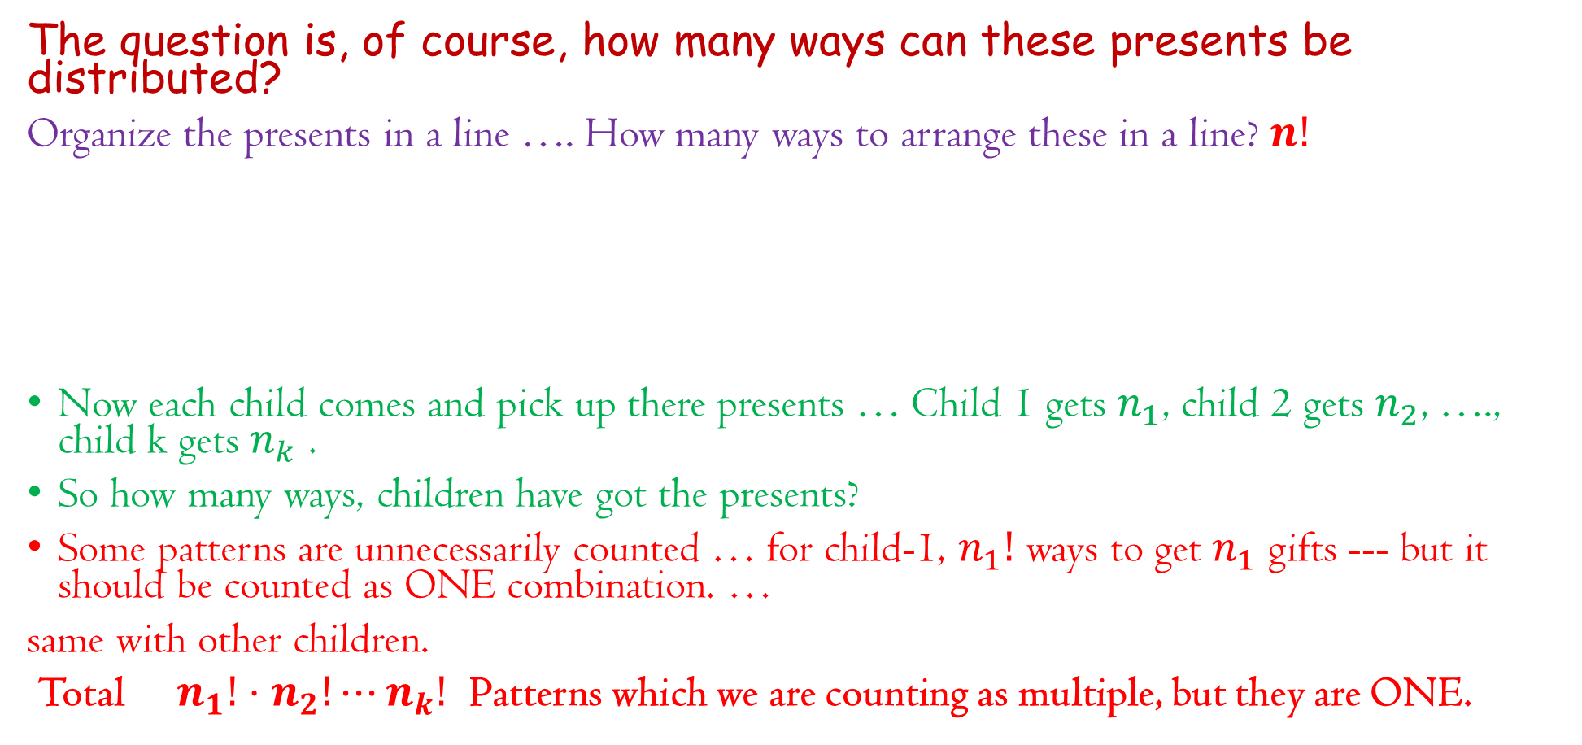
Distributing Presents (Section 3.2 of textbook)
The question is, of course, how many ways can these presents be distributed?
Organize the presents in a line …. How many ways to arrange these in a line? $n!$
Now each child comes and pick up there presents … Child 1 gets $n_{1}$, child 2 gets $n_{2}$, …., child k gets $n_{k}$ .
So how many ways, children have got the presents?
Some patterns are unnecessarily counted … for child-1, $n_{1}!$ ways to get $n_{1}$ gifts --- but it should be counted as ONE combination. …
same with other children.
Total $n_{1}!⋅n_{2}!⋯n_{k}!$ Patterns which we are counting as multiple, but they are ONE.

Slide 7
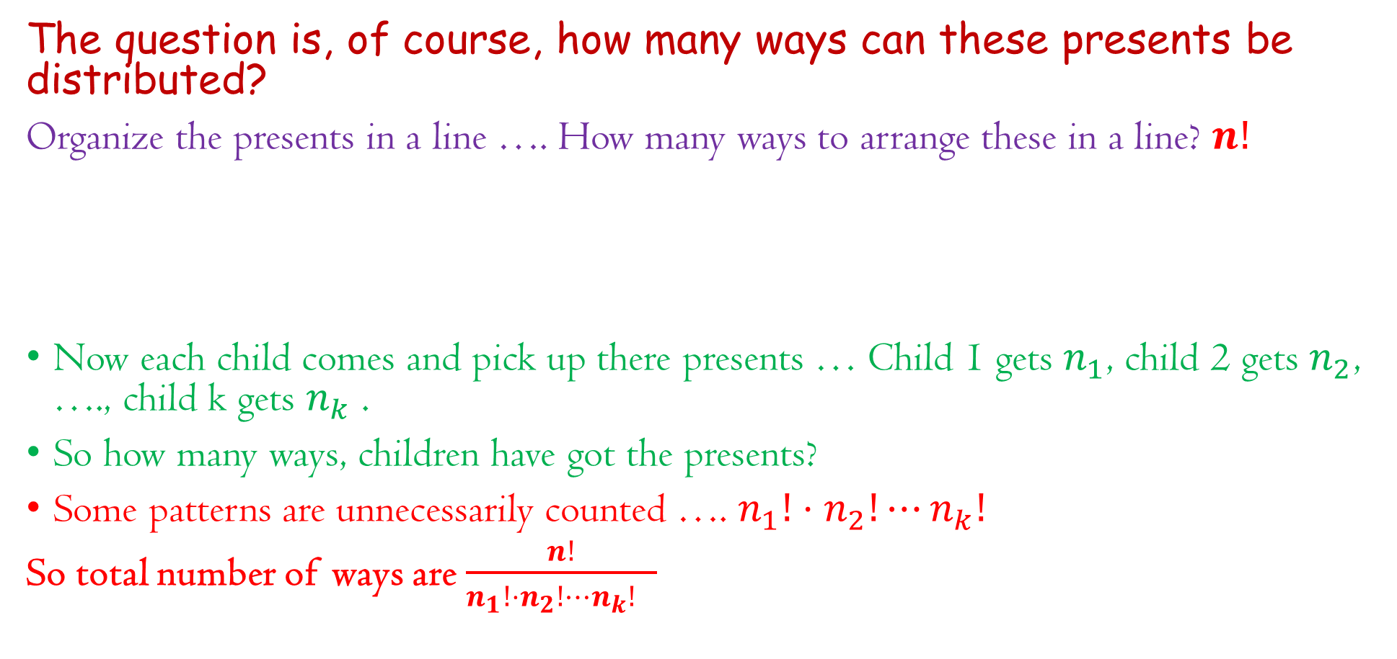
Distributing Presents (Section 3.2 of textbook)
The question is, of course, how many ways can these presents be distributed?
Organize the presents in a line …. How many ways to arrange these in a line? $n!$
Now each child comes and pick up there presents … Child 1 gets $n_{1}$, child 2 gets $n_{2}$, …., child k gets $n_{k}$ .
So how many ways, children have got the presents?
Some patterns are unnecessarily counted …. $n_{1}!⋅n_{2}!⋯n_{k}!$
So total number of ways are $\frac{n!}{n_{1}!⋅n_{2}!⋯n_{k}! }$

Slide 8

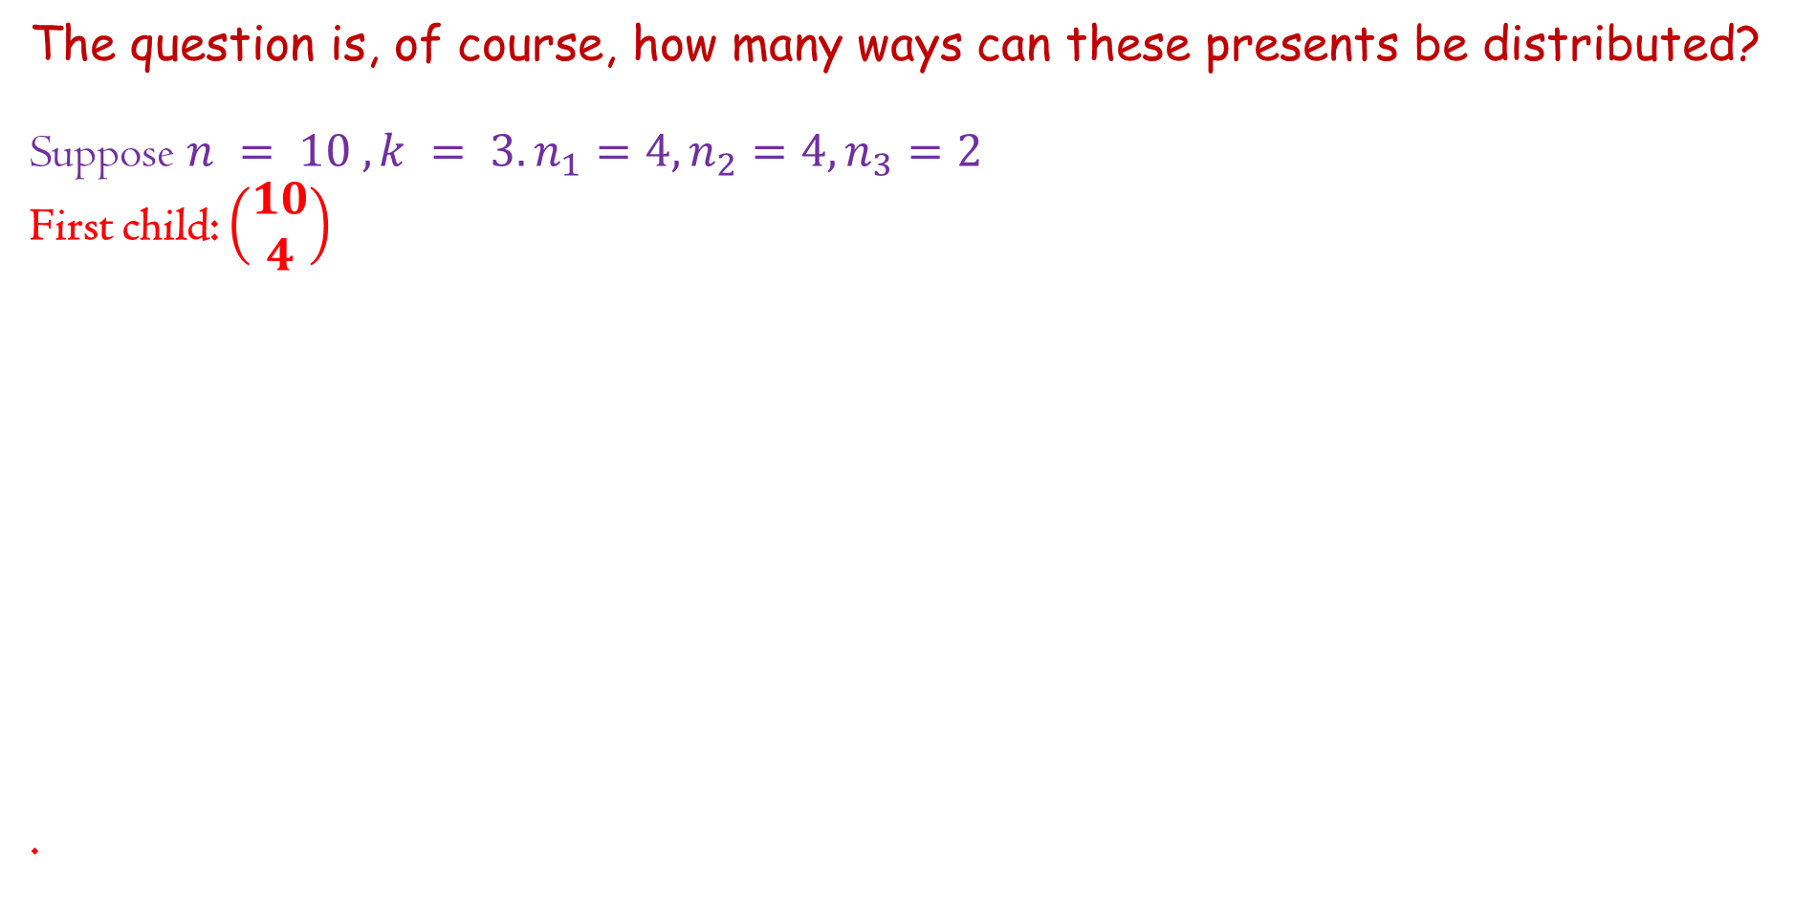
Distributing Presents (Section 3.2 of textbook)
The question is, of course, how many ways can these presents be distributed?
Suppose $n = 10 , k = 3. n_{1}=4, n_{2}=4, n_{3}=2$
First child: $\left(\begin{aligned}10 \\ 4\end{aligned}\right)$
.

Slide 9

Distributing Presents (Section 3.2 of textbook)
The question is, of course, how many ways can these presents be distributed?
Suppose $n = 10 , k = 3. n_{1}=4, n_{2}=4, n_{3}=2$
First child: $\left(\begin{aligned}10 \\ 4\end{aligned}\right)$
Second child: $\left(\begin{aligned}6 \\ 4\end{aligned}\right)$
.

Slide 10

Distributing Presents (Section 3.2 of textbook)
The question is, of course, how many ways can these presents be distributed?
Suppose $n = 10 , k = 3. n_{1}=4, n_{2}=4, n_{3}=2$
First child: $\left(\begin{aligned}10 \\ 4\end{aligned}\right)$
Second child: $\left(\begin{aligned}6 \\ 4\end{aligned}\right)$
Third child: $\left(\begin{aligned}2 \\ 2\end{aligned}\right)$
.

Slide 11
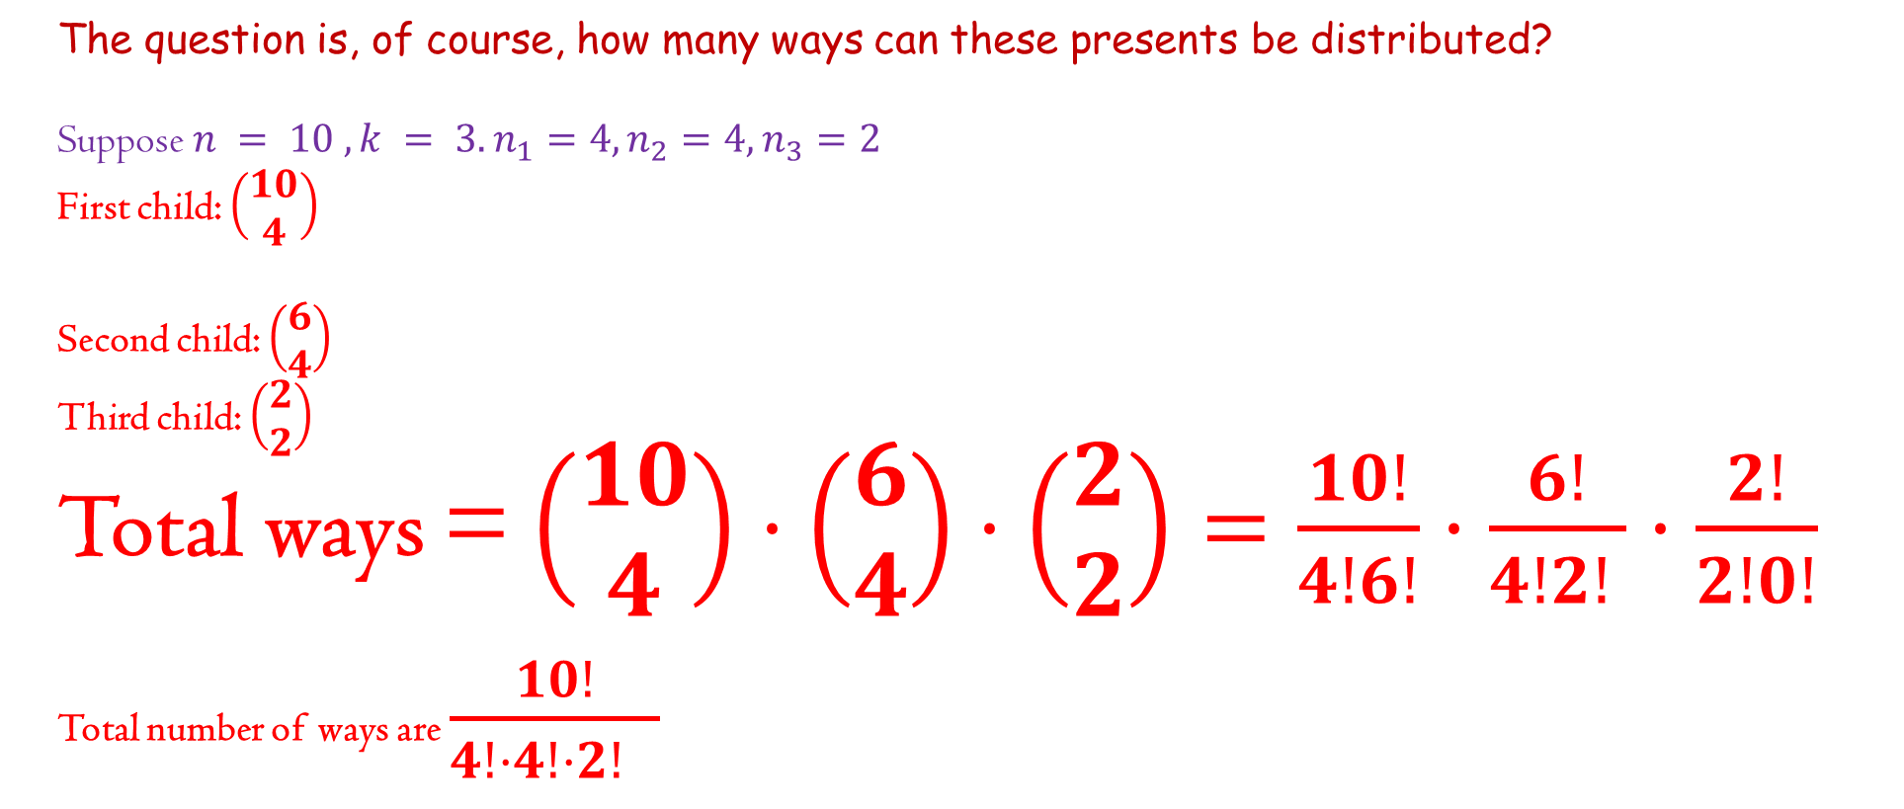
Distributing Presents (Section 3.2 of textbook)
The question is, of course, how many ways can these presents be distributed?
Suppose $n = 10 , k = 3. n_{1}=4, n_{2}=4, n_{3}=2$
First child: $\left(\begin{aligned}10 \\ 4\end{aligned}\right)$
Second child: $\left(\begin{aligned}6 \\ 4\end{aligned}\right)$
Third child: $\left(\begin{aligned}2 \\ 2\end{aligned}\right)$
Total ways = $\left(\begin{aligned}10 \\ 4\end{aligned}\right)⋅\left(\begin{aligned}6 \\ 4\end{aligned}\right)⋅\left(\begin{aligned}2 \\ 2\end{aligned}\right)=\frac{10!}{4!6!}⋅\frac{6!}{4!2! }⋅\frac{2!}{2!0!}$
Total number of ways are $\frac{10!}{4!⋅4!⋅2! }$

Slide 12

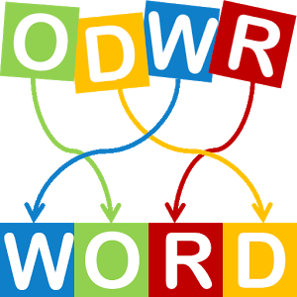
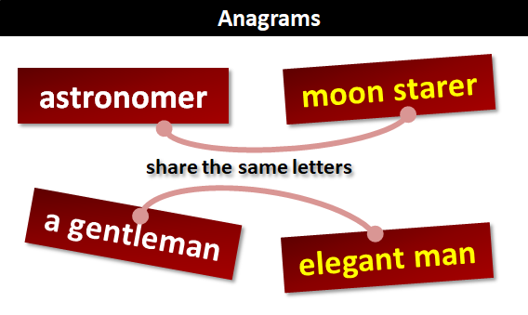
Anagrams (Section 3.3 of textbook)
ANNAGRAMS

Slide 13
Anagrams (Section 3.3 of textbook)
ANNAGRAMS
Which anagrams we may make with COMBINATORICS?
A CROC BIT SIMON
TOMB IN CORSICA
COB IS ROMANTIC
MAC IN ROBOTICS
ROBIN COSMICAT
COSMIC RIOT BAN
TO COSMIC BRAIN
MTBIRASCIONOC

Slide 14
Anagrams (Section 3.3 of textbook)
ANNAGRAMS
Which anagrams we may make with COMBINATORICS?
HOW MANY?

Slide 15

Problem 11
We have 11 letters where few letters are repeated…. E.g. M, A, T

Slide 16

Problem 11
We have 11 letters where few letters are repeated…. E.g. M, A, T
If we start from M, we can place M at any of the 11 place … so we have $\left(\begin{aligned}11 \\ 2\end{aligned}\right)$ ways

Slide 17
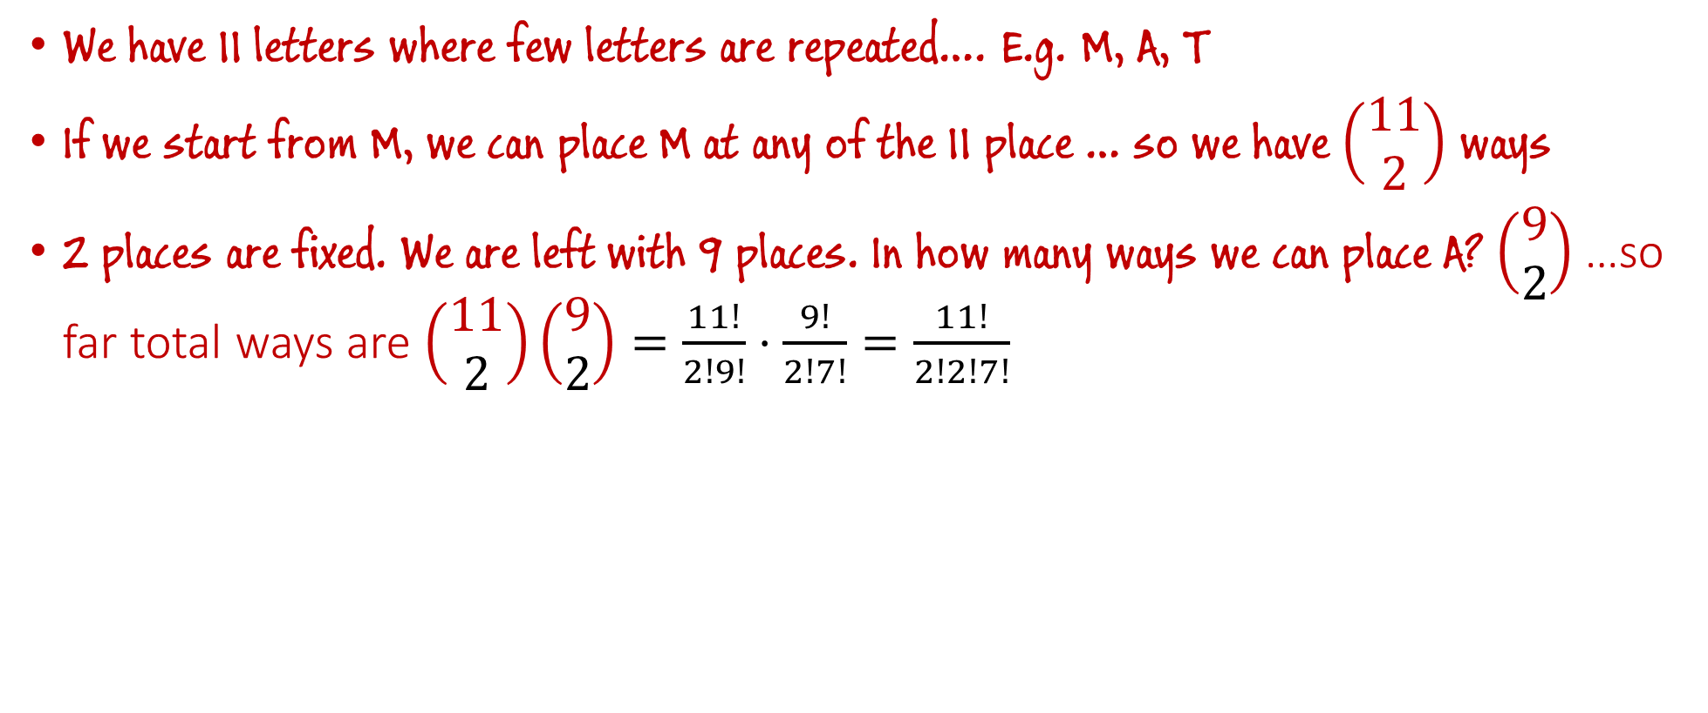
Problem 11
We have 11 letters where few letters are repeated…. E.g. M, A, T
If we start from M, we can place M at any of the 11 place … so we have $\left(\begin{aligned}11 \\ 2\end{aligned}\right)$ ways
2 places are fixed. We are left with 9 places. In how many ways we can place A? $\left(\begin{aligned}9 \\ 2\end{aligned}\right)$ …so far total ways are $\left(\begin{aligned}11 \\ 2\end{aligned}\right)\left(\begin{aligned}9 \\ 2\end{aligned}\right)=\frac{11!}{2!9!}⋅\frac{9!}{2!7!}=\frac{11!}{2!2!7!}$

Slide 18
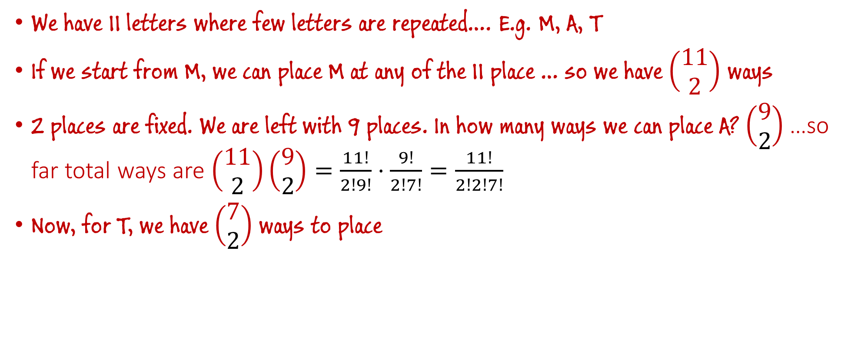
Problem 11
We have 11 letters where few letters are repeated…. E.g. M, A, T
If we start from M, we can place M at any of the 11 place … so we have $\left(\begin{aligned}11 \\ 2\end{aligned}\right)$ ways
2 places are fixed. We are left with 9 places. In how many ways we can place A? $\left(\begin{aligned}9 \\ 2\end{aligned}\right)$ …so far total ways are $\left(\begin{aligned}11 \\ 2\end{aligned}\right)\left(\begin{aligned}9 \\ 2\end{aligned}\right)=\frac{11!}{2!9!}⋅\frac{9!}{2!7!}=\frac{11!}{2!2!7!}$
Now, for T, we have $\left(\begin{aligned}7 \\ 2\end{aligned}\right)$ ways to place

Slide 19
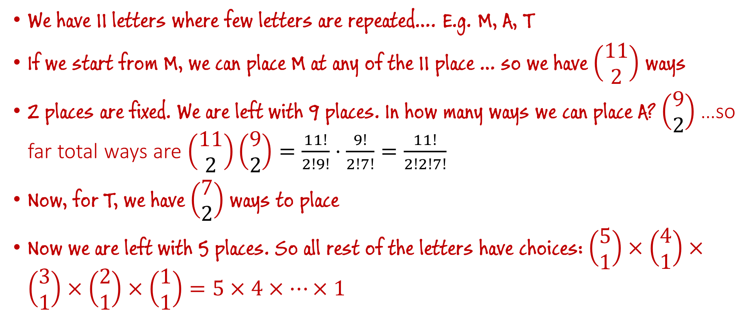
Problem 11
We have 11 letters where few letters are repeated…. E.g. M, A, T
If we start from M, we can place M at any of the 11 place … so we have $\left(\begin{aligned}11 \\ 2\end{aligned}\right)$ ways
2 places are fixed. We are left with 9 places. In how many ways we can place A? $\left(\begin{aligned}9 \\ 2\end{aligned}\right)$ …so far total ways are $\left(\begin{aligned}11 \\ 2\end{aligned}\right)\left(\begin{aligned}9 \\ 2\end{aligned}\right)=\frac{11!}{2!9!}⋅\frac{9!}{2!7!}=\frac{11!}{2!2!7!}$
Now, for T, we have $\left(\begin{aligned}7 \\ 2\end{aligned}\right)$ ways to place
Now we are left with 5 places. So all rest of the letters have choices: $\left(\begin{aligned}5 \\ 1\end{aligned}\right)×\left(\begin{aligned}4 \\ 1\end{aligned}\right)×\left(\begin{aligned}3 \\ 1\end{aligned}\right)×\left(\begin{aligned}2 \\ 1\end{aligned}\right)×\left(\begin{aligned}1 \\ 1\end{aligned}\right)=5×4×⋯×1$

Slide 20
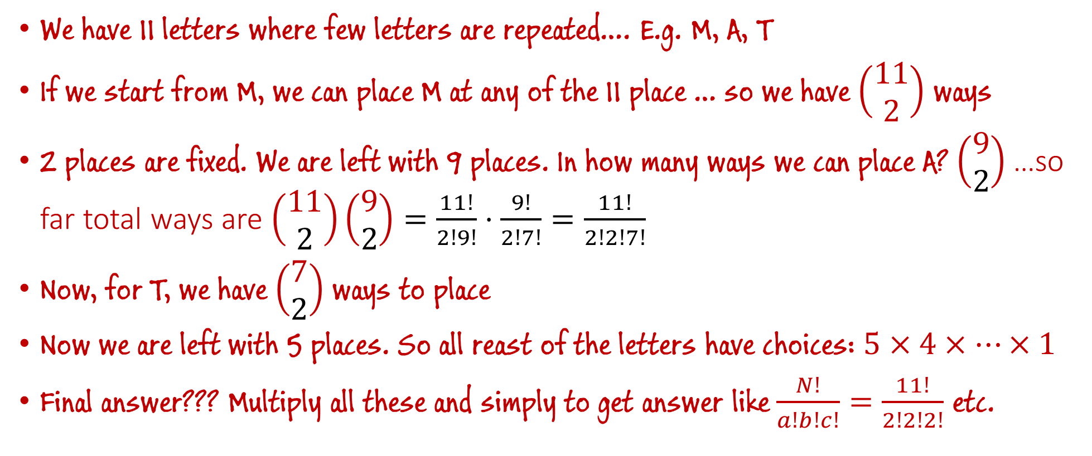
Problem 11
We have 11 letters where few letters are repeated…. E.g. M, A, T
If we start from M, we can place M at any of the 11 place … so we have $\left(\begin{aligned}11 \\ 2\end{aligned}\right)$ ways
2 places are fixed. We are left with 9 places. In how many ways we can place A? $\left(\begin{aligned}9 \\ 2\end{aligned}\right)$ …so far total ways are $\left(\begin{aligned}11 \\ 2\end{aligned}\right)\left(\begin{aligned}9 \\ 2\end{aligned}\right)=\frac{11!}{2!9!}⋅\frac{9!}{2!7!}=\frac{11!}{2!2!7!}$
Now, for T, we have $\left(\begin{aligned}7 \\ 2\end{aligned}\right)$ ways to place
Now we are left with 5 places. So all reast of the letters have choices: $5×4×⋯×1$
Final answer??? Multiply all these and simply to get answer like $\frac{N!}{a!b!c!}=\frac{11!}{2!2!2!}$ etc.

Slide 21
Anagrams (Section 3.3 of textbook)
ANNAGRAMS
Which anagrams we may make with COMBINATORICS?
HOW MANY?
We have 13 letters in total – C:2, O:2, I:2, M:1, B:1, N:1, A:1, T:1, R:1, S:1

Slide 22
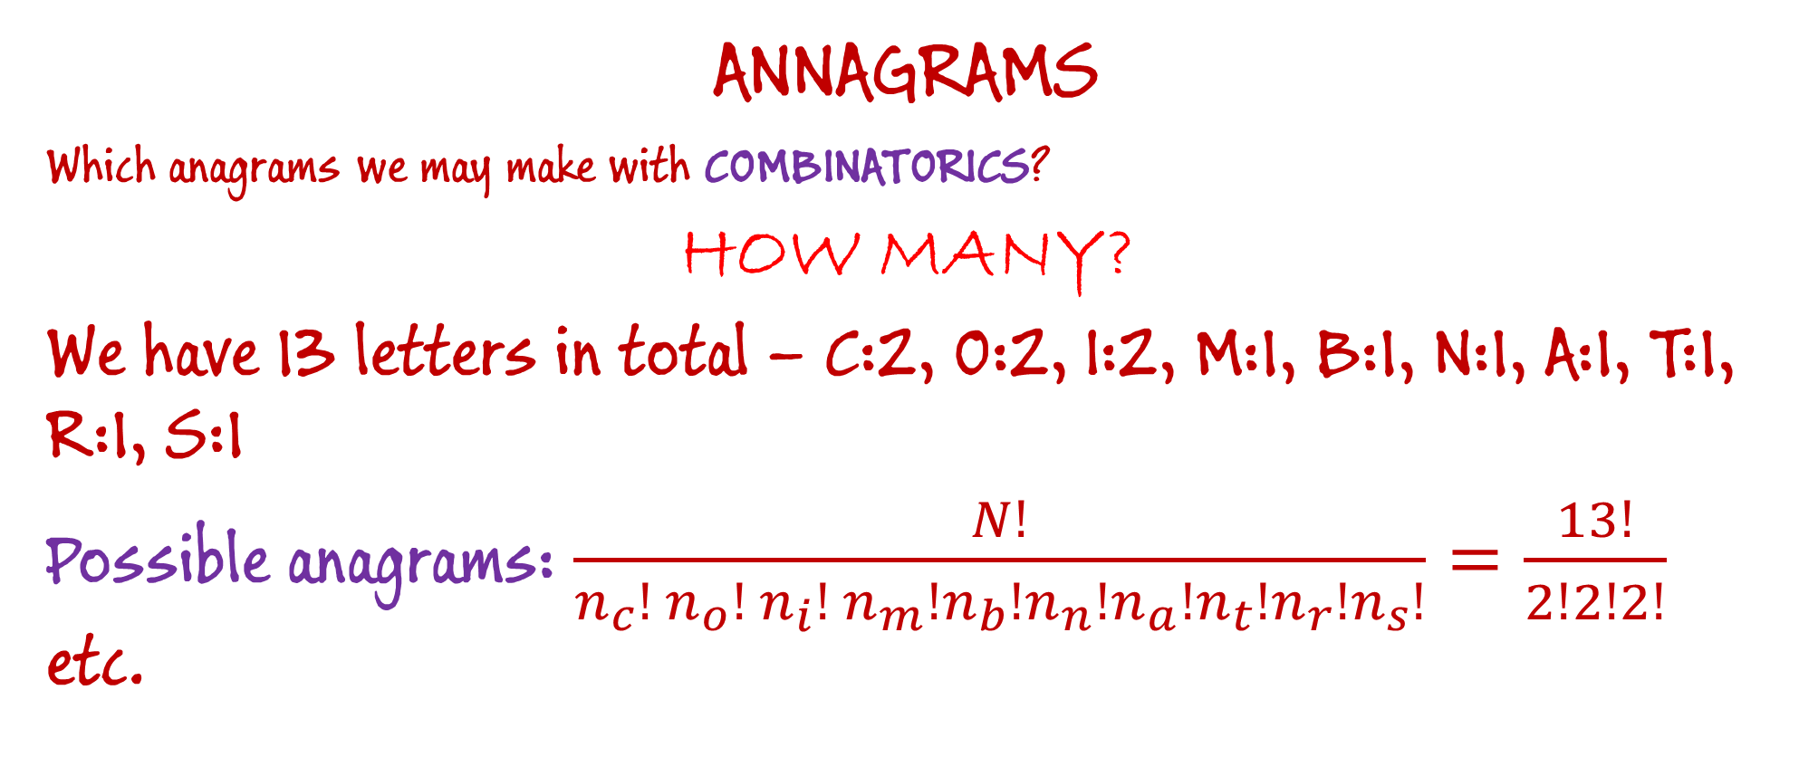
Anagrams (Section 3.3 of textbook)
ANNAGRAMS
Which anagrams we may make with COMBINATORICS?
HOW MANY?
We have 13 letters in total – C:2, O:2, I:2, M:1, B:1, N:1, A:1, T:1, R:1, S:1
Possible anagrams: $\frac{N!}{n_{c}! n_{o}!{ n}_{i}! n_{m}!n_{b}!n_{n}!n_{a}!n_{t}!n_{r}!n_{s}!}=\frac{13!}{2!2!2!}$ etc.

Slide 23
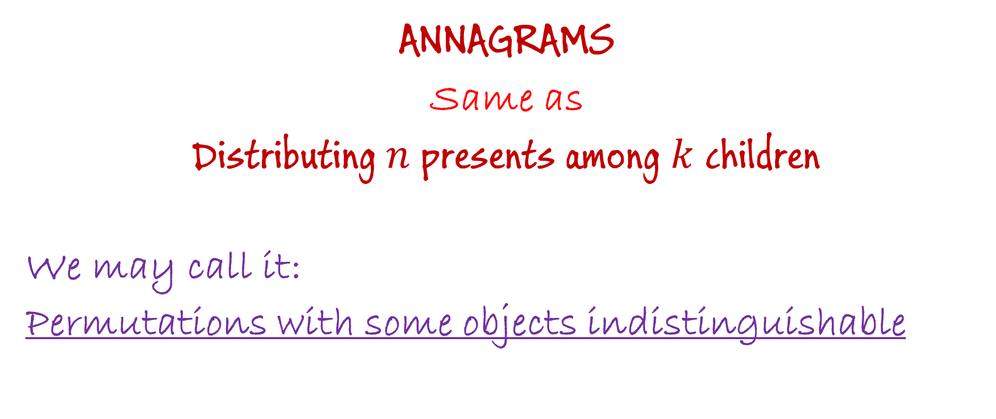
Anagrams (Section 3.3 of textbook)
ANNAGRAMS
Same as
Distributing $n$ presents among $k$ children
We may call it:
Permutations with some objects indistinguishable

Slide 24
Distributing Gifts (Section 3.2 of textbook)
Suppose we have $n$ different presents, which we want to distribute to $k$ children.
We are told how many presents each child should get.
We label the children 1, 2, . . . , k; thus we are given the numbers $n_{1}, n_{2}, ⋯, n_{k}$. We assume that $n_{1}+n_{2}, ⋯,+n_{k}=n.$
The question is, of course, how many ways can these presents be distributed?

Slide 25
Distributing Presents (Section 3.2 of textbook)
The question is, of course, how many ways can these presents be distributed?
Organize the presents in a line …. How many ways to arrange these $n$ gifts in a line?

Slide 26
Distributing Presents (Section 3.2 of textbook)
The question is, of course, how many ways can these presents be distributed?
Organize the presents in a line …. How many ways to arrange these in a line? $n!$
Now each child comes and pick up there presents … Child 1 gets $n_{1}$, child 2 gets $n_{2}$, …., child k gets $n_{k}$ .
So how many ways, children have got the presents?

Slide 27
Distributing Presents (Section 3.2 of textbook)
The question is, of course, how many ways can these presents be distributed?
Organize the presents in a line …. How many ways to arrange these in a line? $n!$
Now each child comes and pick up there presents … Child 1 gets $n_{1}$, child 2 gets $n_{2}$, …., child k gets $n_{k}$ .
So how many ways, children have got the presents?
Some patterns are unnecessarily counted … for child-1, $n_{1}!$ ways to get $n_{1}$ gifts --- but it should be counted as ONE combination. …
same with other children.

Slide 28
Distributing Presents (Section 3.2 of textbook)
The question is, of course, how many ways can these presents be distributed?
Organize the presents in a line …. How many ways to arrange these in a line? $n!$
Now each child comes and pick up there presents … Child 1 gets $n_{1}$, child 2 gets $n_{2}$, …., child k gets $n_{k}$ .
So how many ways, children have got the presents?
Some patterns are unnecessarily counted … for child-1, $n_{1}!$ ways to get $n_{1}$ gifts --- but it should be counted as ONE combination. …
same with other children.
Total $n_{1}!⋅n_{2}!⋯n_{k}!$ Patterns which we are counting as multiple, but they are ONE.

Slide 29
Distributing Presents (Section 3.2 of textbook)
The question is, of course, how many ways can these presents be distributed?
Organize the presents in a line …. How many ways to arrange these in a line? $n!$
Now each child comes and pick up there presents … Child 1 gets $n_{1}$, child 2 gets $n_{2}$, …., child k gets $n_{k}$ .
So how many ways, children have got the presents?
Some patterns are unnecessarily counted …. $n_{1}!⋅n_{2}!⋯n_{k}!$
So total number of ways are $\frac{n!}{n_{1}!⋅n_{2}!⋯n_{k}! }$

Slide 30
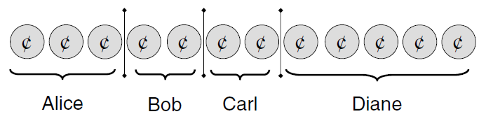

Distributing Money (Section 3.4 of textbook)
Suppose we have $n$ same coins, which we want to distribute to $k$ children, each children should get at least ONE coin.
We are told how many coins each child should get.
We label the children 1, 2, . . . , k; thus we are given the numbers $n_{1}, n_{2}, ⋯, n_{k}$. So $n_{1}+n_{2}, ⋯,+n_{k}=n.$

Slide 31
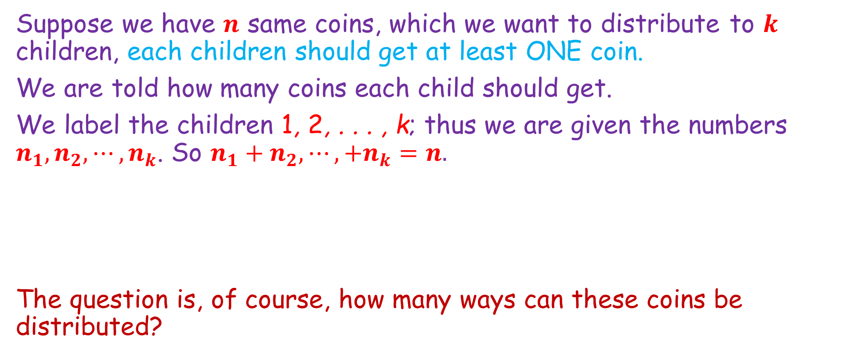
Distributing Money (Section 3.4 of textbook)
Suppose we have $n$ same coins, which we want to distribute to $k$ children, each children should get at least ONE coin.
We are told how many coins each child should get.
We label the children 1, 2, . . . , k; thus we are given the numbers $n_{1}, n_{2}, ⋯, n_{k}$. So $n_{1}+n_{2}, ⋯,+n_{k}=n.$
The question is, of course, how many ways can these coins be distributed?

Slide 32
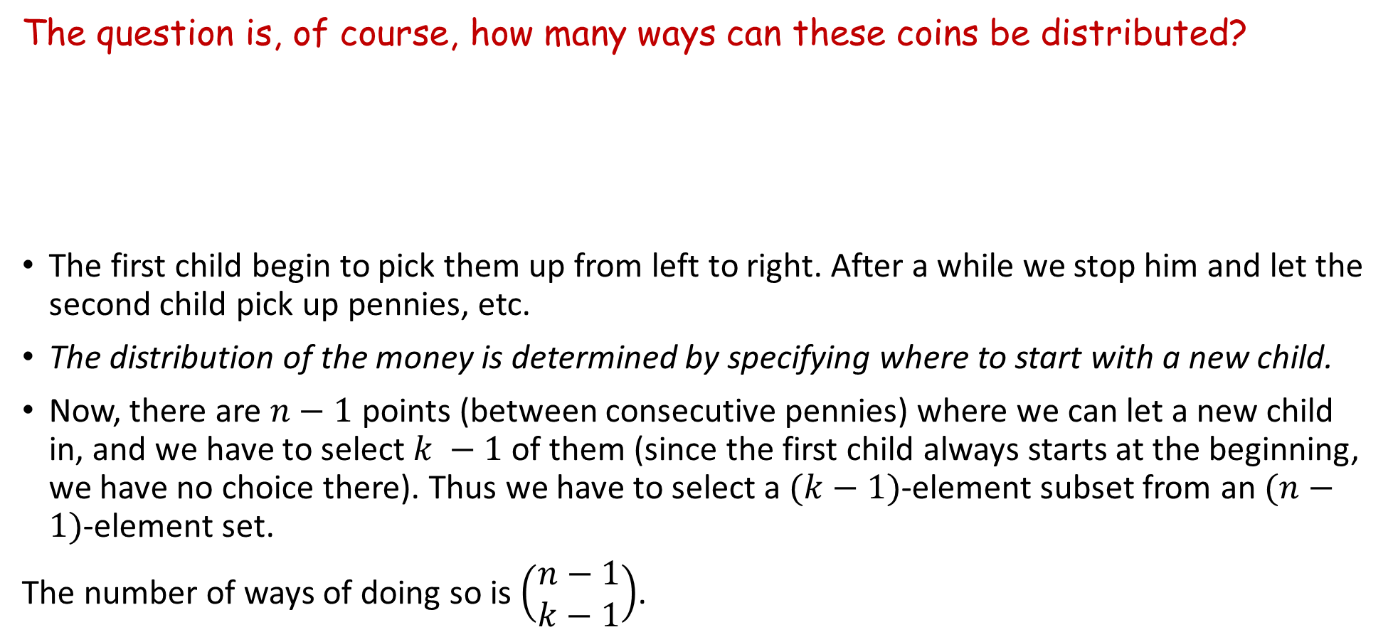
Distributing Money (Section 3.4 of textbook)
The question is, of course, how many ways can these coins be distributed?
The first child begin to pick them up from left to right. After a while we stop him and let the second child pick up pennies, etc.
The distribution of the money is determined by specifying where to start with a new child.
Now, there are $n−1$ points (between consecutive pennies) where we can let a new child in, and we have to select $k −1$ of them (since the first child always starts at the beginning, we have no choice there). Thus we have to select a $(k−1)$-element subset from an $(n−1)$-element set.
The number of ways of doing so is $\left(\begin{aligned}n−1 \\ k−1\end{aligned}\right)$.

Slide 33

Distributing Money (Section 3.4 of textbook)
The question is, of course, how many ways can these coins be distributed?

Slide 34
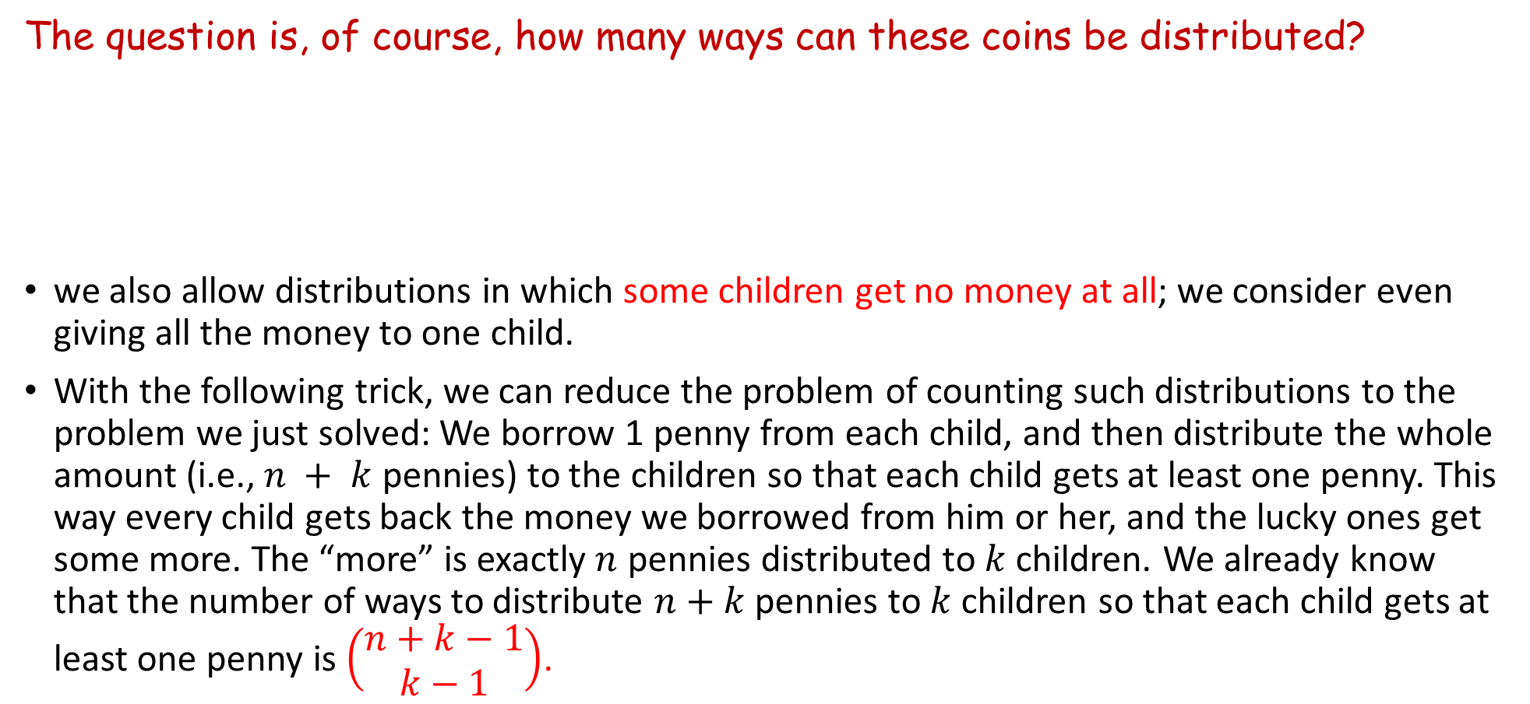
Distributing Money (Section 3.4 of textbook)
The question is, of course, how many ways can these coins be distributed?
we also allow distributions in which some children get no money at all; we consider even giving all the money to one child.
With the following trick, we can reduce the problem of counting such distributions to the problem we just solved: We borrow 1 penny from each child, and then distribute the whole amount (i.e., $n + k$ pennies) to the children so that each child gets at least one penny. This way every child gets back the money we borrowed from him or her, and the lucky ones get some more. The “more” is exactly $n$ pennies distributed to $k$ children. We already know that the number of ways to distribute $n+k$ pennies to $k$ children so that each child gets at least one penny is $\left(\begin{aligned}n+k−1 \\ k−1\end{aligned}\right)$.

Slide 35

Distributing Money (Section 3.4 of textbook)
The question is, of course, how many ways can these coins be distributed?
So we have the next result:

Slide 36
Distributing Money (Section 3.4 of textbook)
These kind of problems, we call it:
Combinations with repeated objects

Slide 37
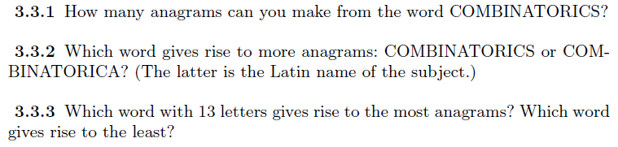
Examples: --- Do it by yourself
EXAMPLES – 1

Slide 38
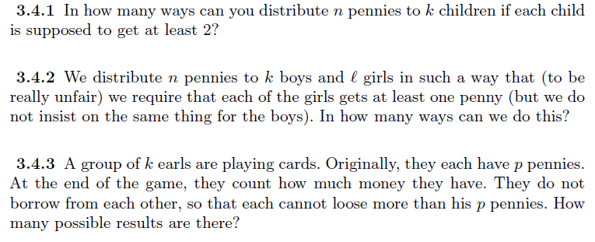
Examples: --- Do it by yourself
EXAMPLES – 2

Slide 39
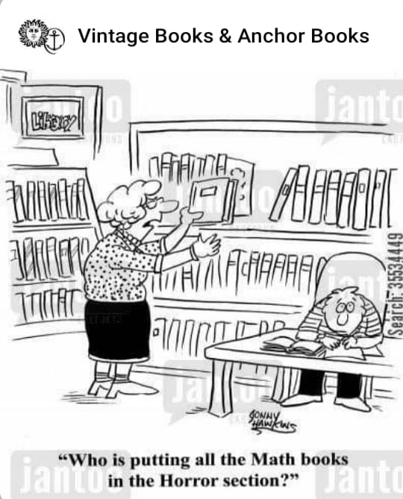

Slide 40
Permutations with Repetitions
Examples: ---

Slide 41
Permutations with Repetitions
Examples: ---

Slide 42
Combinations with Repetition
Examples: ---

Slide 43
Combinations with Repetition
Examples: ---

Slide 44
Combinations with Repetition
Examples: ---

Slide 45
Combinations with Repetition
Examples: ---

Slide 47

Combinations with Repetition
Examples: ---

Slide 48
Combinations with Repetition
Examples: ---

Slide 49
Combinations with Repetition
Examples: ---

Slide 50
Combinations with Repetition
Examples: ---

Slide 51
Combinations with Repetition
Examples: ---

Slide 53
Combinations with Repetition
Examples: ---

Slide 54
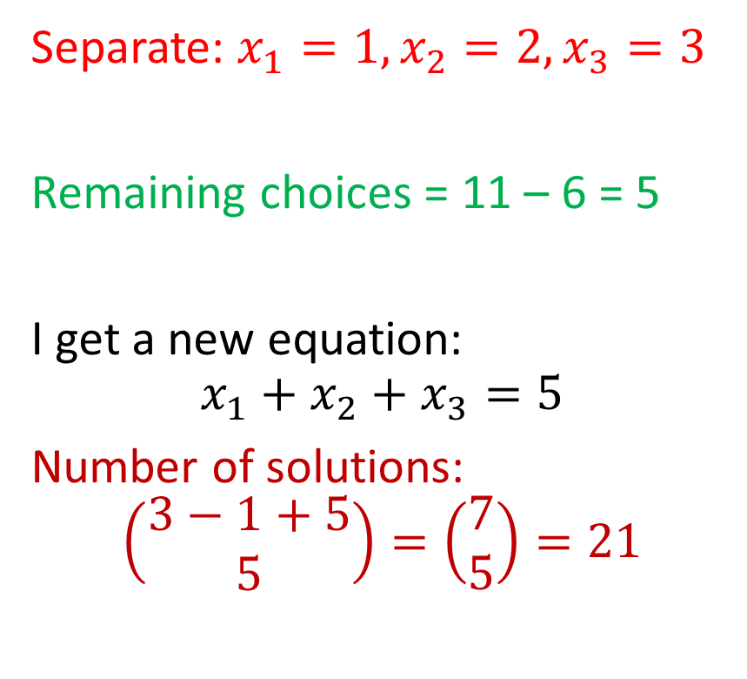
Combinations with Repetition
Examples: ---
Separate: $x_{1}=1, x_{2}=2, x_{3}=3$
Remaining choices = 11 – 6 = 5
I get a new equation:
$$x_{1}+x_{2}+x_{3}=5$$
Number of solutions:
$$\left(\begin{aligned}3−1+5 \\ 5\end{aligned}\right)=\left(\begin{aligned}7 \\ 5\end{aligned}\right)=21$$

Slide 55
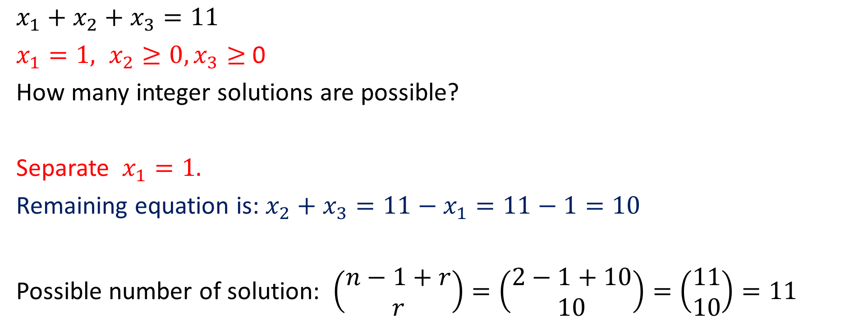
More problems on number of solutions of equation
$x_{1}+x_{2}+x_{3}=11$
$x_{1}=1, x_{2}≥0, x_{3}≥$0
How many integer solutions are possible?
Separate $x_{1}=1.$
Remaining equation is:$x_{2}+x_{3}=11−x_{1}=11−1=10$
Possible number of solution: $\left(\begin{aligned}n−1+r \\ r\end{aligned}\right)=\left(\begin{aligned}2−1+10 \\ 10\end{aligned}\right)=\left(\begin{aligned}11 \\ 10\end{aligned}\right)=11$

Slide 56
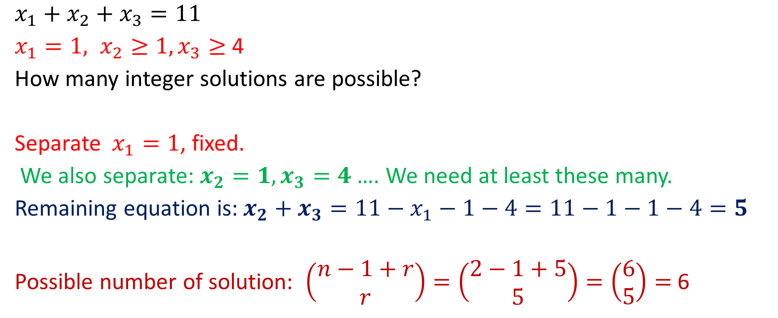
More problems on number of solutions of equation
$x_{1}+x_{2}+x_{3}=11$
$x_{1}=1, x_{2}≥1, x_{3}≥$ 4
How many integer solutions are possible?
Separate $x_{1}=1$, fixed.
We also separate: $x_{2}=1, x_{3}=4$ …. We need at least these many.
Remaining equation is:$x_{2}+x_{3}=11−x_{1}−1−4=11−1−1−4=5$
Possible number of solution: $\left(\begin{aligned}n−1+r \\ r\end{aligned}\right)=\left(\begin{aligned}2−1+5 \\ 5\end{aligned}\right)=\left(\begin{aligned}6 \\ 5\end{aligned}\right)=$ 6

Slide 57
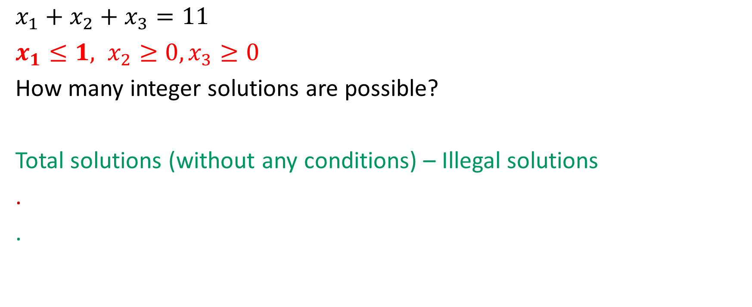
More problems on number of solutions of equation
$x_{1}+x_{2}+x_{3}=11$
$x_{1}≤1, x_{2}≥0, x_{3}≥0$
How many integer solutions are possible?
Total solutions (without any conditions) – Illegal solutions
.
.

Slide 58
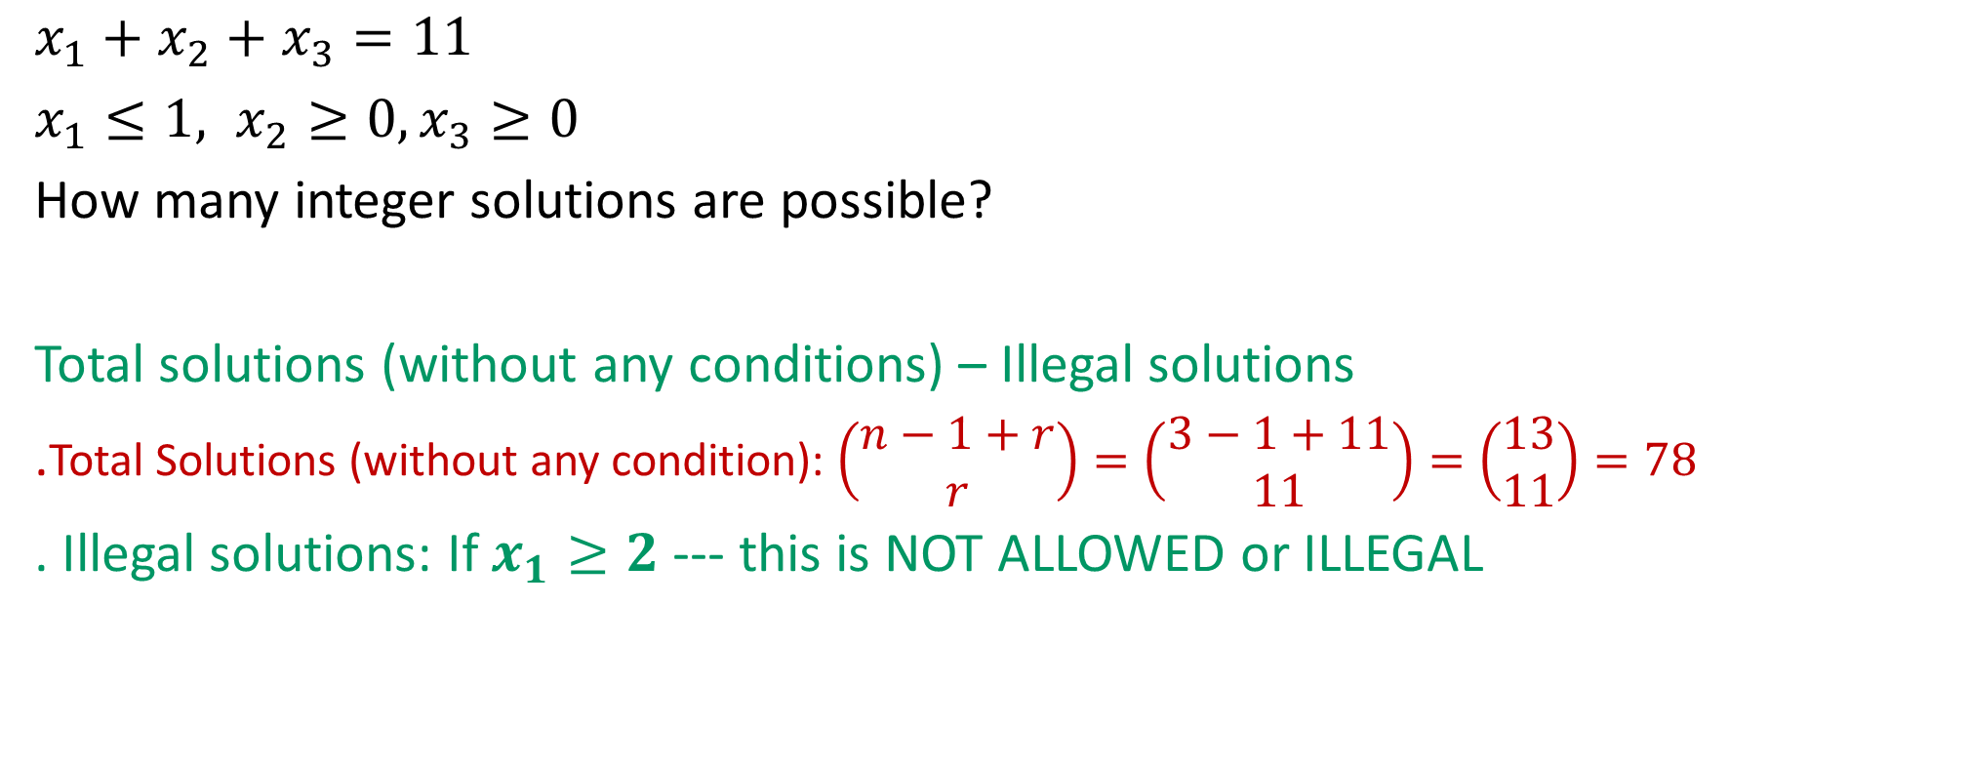
More problems on number of solutions of equation
$x_{1}+x_{2}+x_{3}=11$
$x_{1}≤1, x_{2}≥0, x_{3}≥0$
How many integer solutions are possible?
Total solutions (without any conditions) – Illegal solutions
.Total Solutions (without any condition): $\left(\begin{aligned}n−1+r \\ r\end{aligned}\right)=\left(\begin{aligned}3−1+11 \\ 11\end{aligned}\right)=\left(\begin{aligned}13 \\ 11\end{aligned}\right)=78$
. Illegal solutions: If $x_{1}≥2$ --- this is NOT ALLOWED or ILLEGAL

Slide 59
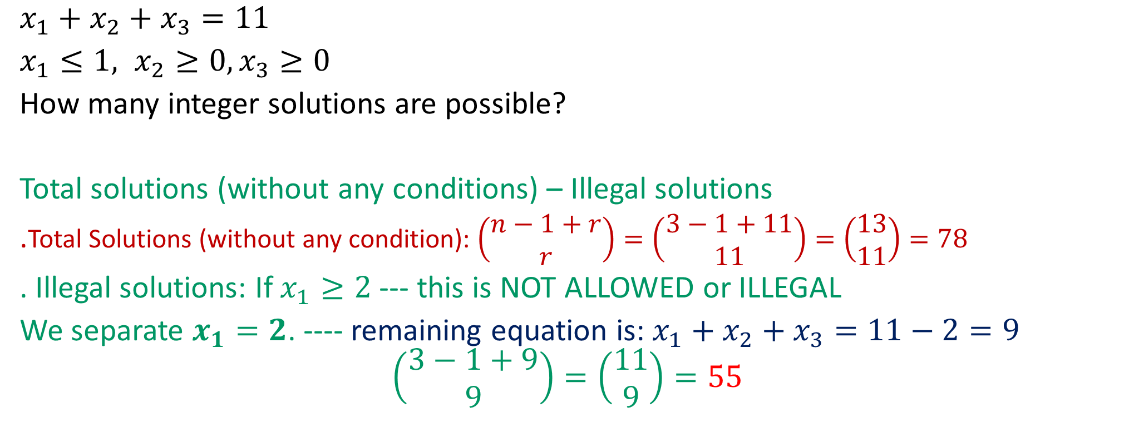
More problems on number of solutions of equation
$x_{1}+x_{2}+x_{3}=11$
$x_{1}≤1, x_{2}≥0, x_{3}≥0$
How many integer solutions are possible?
Total solutions (without any conditions) – Illegal solutions
.Total Solutions (without any condition): $\left(\begin{aligned}n−1+r \\ r\end{aligned}\right)=\left(\begin{aligned}3−1+11 \\ 11\end{aligned}\right)=\left(\begin{aligned}13 \\ 11\end{aligned}\right)=78$
. Illegal solutions: If $x_{1}≥2$ --- this is NOT ALLOWED or ILLEGAL
We separate $x_{1}=2$. ---- remaining equation is: $x_{1}+x_{2}+x_{3}=11−2=9$
$$\left(\begin{aligned}3−1+9 \\ 9\end{aligned}\right)=\left(\begin{aligned}11 \\ 9\end{aligned}\right)=55$$

Slide 60
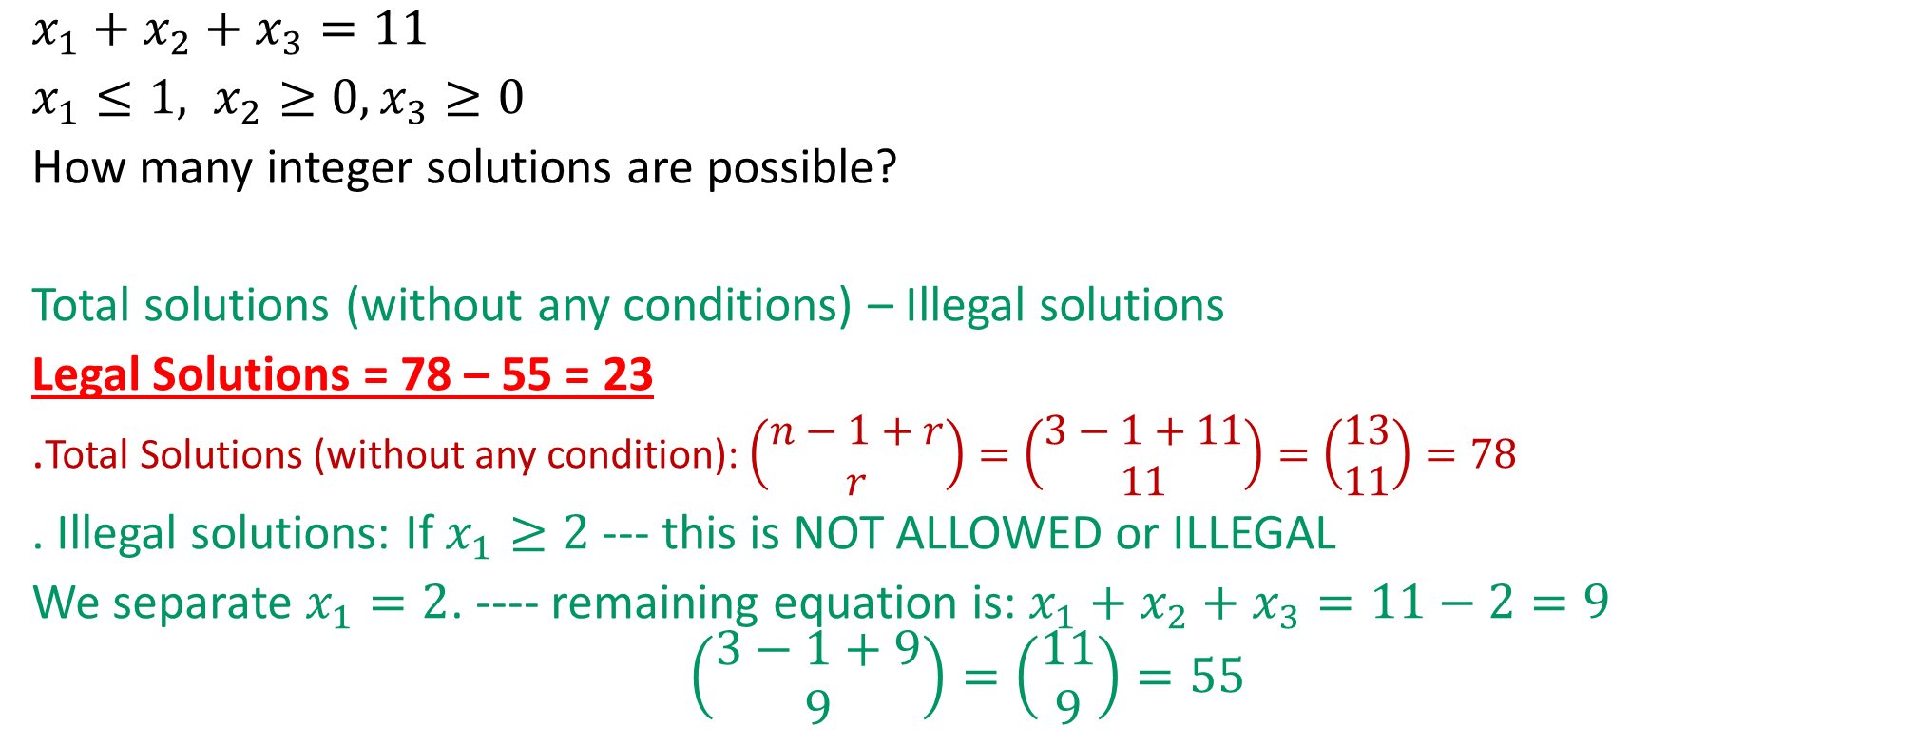
More problems on number of solutions of equation
$x_{1}+x_{2}+x_{3}=11$
$x_{1}≤1, x_{2}≥0, x_{3}≥0$
How many integer solutions are possible?
Total solutions (without any conditions) – Illegal solutions
Legal Solutions = 78 – 55 = 23
.Total Solutions (without any condition): $\left(\begin{aligned}n−1+r \\ r\end{aligned}\right)=\left(\begin{aligned}3−1+11 \\ 11\end{aligned}\right)=\left(\begin{aligned}13 \\ 11\end{aligned}\right)=78$
. Illegal solutions: If $x_{1}≥2$ --- this is NOT ALLOWED or ILLEGAL
We separate $x_{1}=2$. ---- remaining equation is: $x_{1}+x_{2}+x_{3}=11−2=9$
$$\left(\begin{aligned}3−1+9 \\ 9\end{aligned}\right)=\left(\begin{aligned}11 \\ 9\end{aligned}\right)=55$$

Slide 61
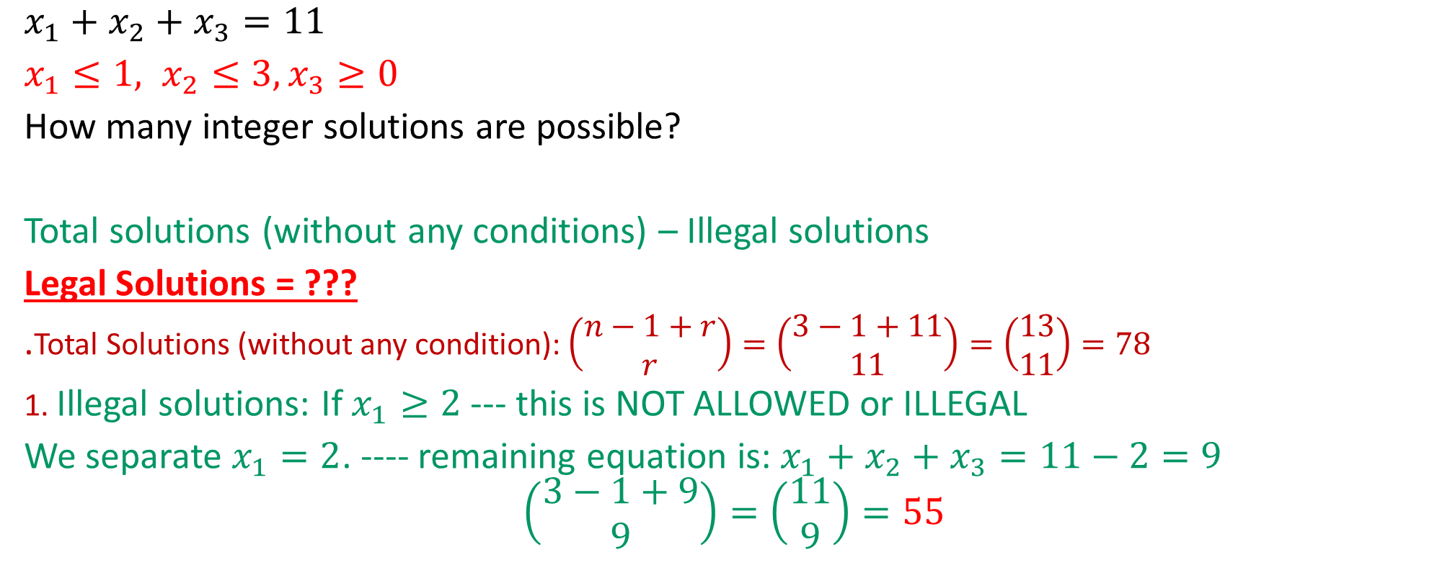
More problems on number of solutions of equation
$x_{1}+x_{2}+x_{3}=11$
$x_{1}≤1, x_{2}≤3, x_{3}≥0$
How many integer solutions are possible?
Total solutions (without any conditions) – Illegal solutions
Legal Solutions = ???
.Total Solutions (without any condition): $\left(\begin{aligned}n−1+r \\ r\end{aligned}\right)=\left(\begin{aligned}3−1+11 \\ 11\end{aligned}\right)=\left(\begin{aligned}13 \\ 11\end{aligned}\right)=78$
1. Illegal solutions: If $x_{1}≥2$ --- this is NOT ALLOWED or ILLEGAL
We separate $x_{1}=2$. ---- remaining equation is: $x_{1}+x_{2}+x_{3}=11−2=9$
$$\left(\begin{aligned}3−1+9 \\ 9\end{aligned}\right)=\left(\begin{aligned}11 \\ 9\end{aligned}\right)=55$$

Slide 62
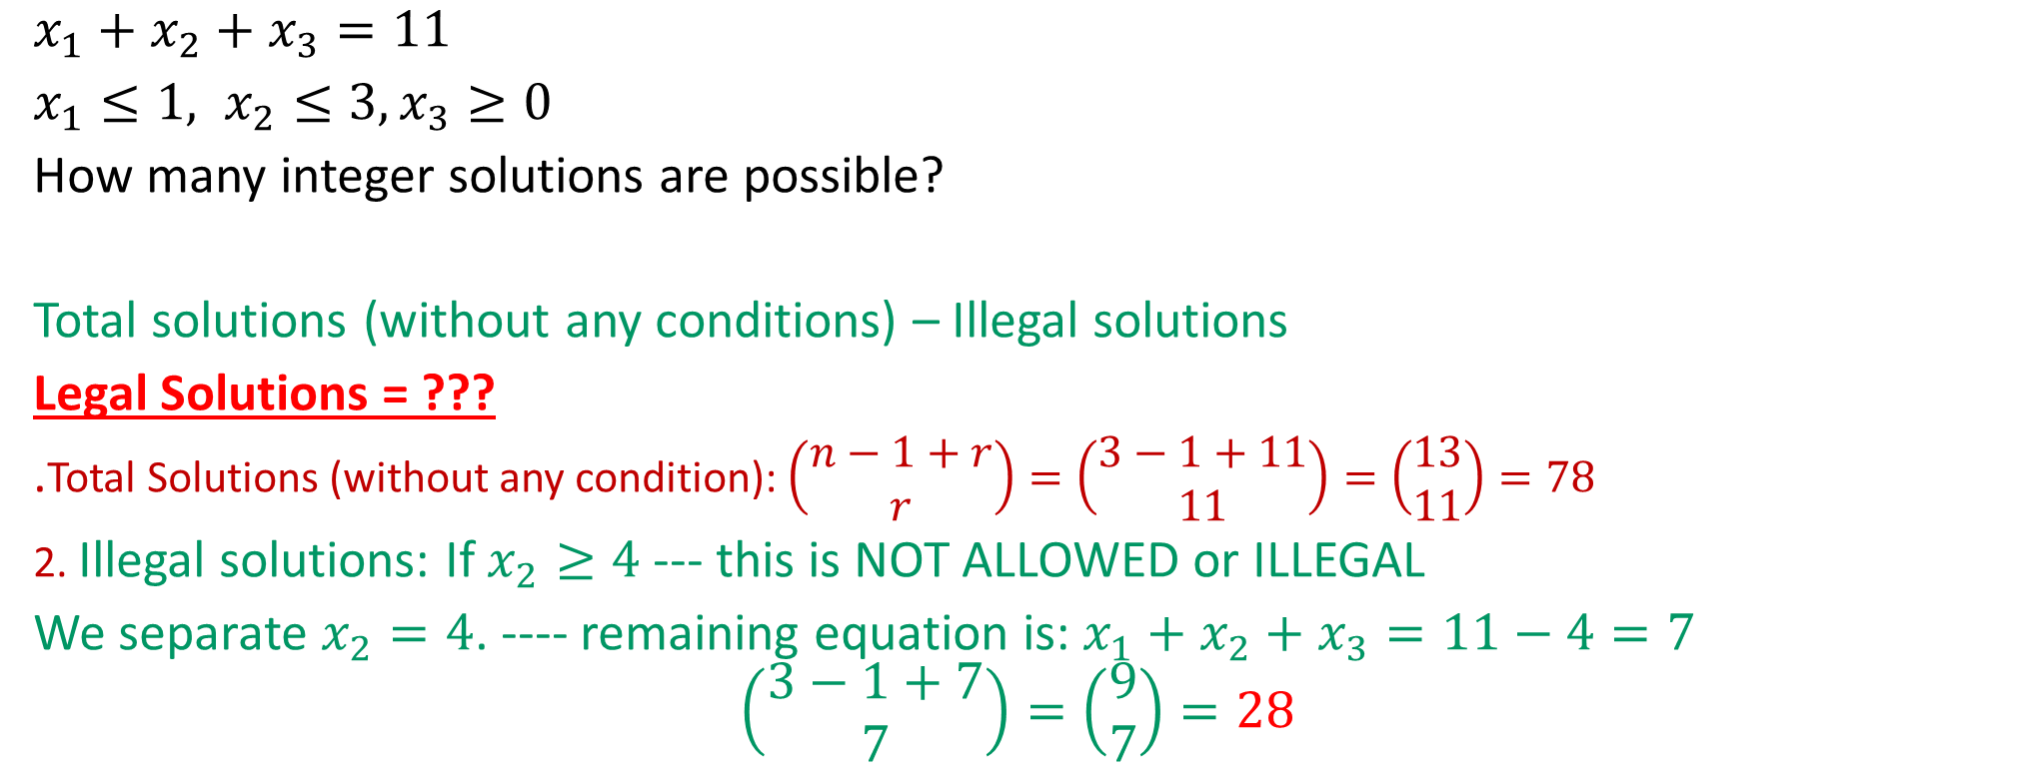
More problems on number of solutions of equation
$x_{1}+x_{2}+x_{3}=11$
$x_{1}≤1, x_{2}≤3, x_{3}≥0$
How many integer solutions are possible?
Total solutions (without any conditions) – Illegal solutions
Legal Solutions = ???
.Total Solutions (without any condition): $\left(\begin{aligned}n−1+r \\ r\end{aligned}\right)=\left(\begin{aligned}3−1+11 \\ 11\end{aligned}\right)=\left(\begin{aligned}13 \\ 11\end{aligned}\right)=78$
2. Illegal solutions: If $x_{2}≥4$ --- this is NOT ALLOWED or ILLEGAL
We separate $x_{2}=4$. ---- remaining equation is: $x_{1}+x_{2}+x_{3}=11−4=7$
$$\left(\begin{aligned}3−1+7 \\ 7\end{aligned}\right)=\left(\begin{aligned}9 \\ 7\end{aligned}\right)=28$$

Slide 63
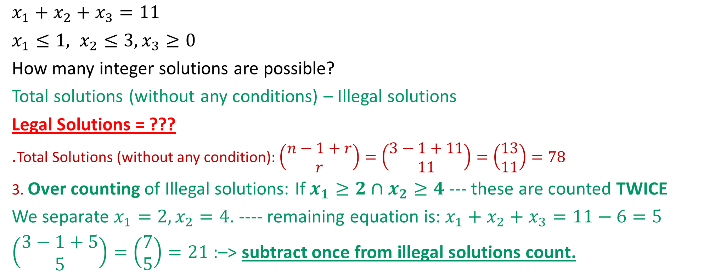
More problems on number of solutions of equation
$x_{1}+x_{2}+x_{3}=11$
$x_{1}≤1, x_{2}≤3, x_{3}≥0$
How many integer solutions are possible?
Total solutions (without any conditions) – Illegal solutions
Legal Solutions = ???
.Total Solutions (without any condition): $\left(\begin{aligned}n−1+r \\ r\end{aligned}\right)=\left(\begin{aligned}3−1+11 \\ 11\end{aligned}\right)=\left(\begin{aligned}13 \\ 11\end{aligned}\right)=78$
3. Over counting of Illegal solutions: If $x_{1}≥2∩x_{2}≥4$ --- these are counted TWICE
We separate ${x_{1}=2, x}_{2}=4$. ---- remaining equation is: $x_{1}+x_{2}+x_{3}=11−6=5$
$\left(\begin{aligned}3−1+5 \\ 5\end{aligned}\right)=\left(\begin{aligned}7 \\ 5\end{aligned}\right)=21$ :–> subtract once from illegal solutions count.

Slide 64
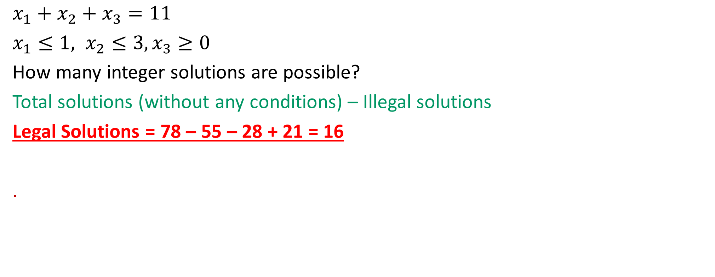
More problems on number of solutions of equation
$x_{1}+x_{2}+x_{3}=11$
$x_{1}≤1, x_{2}≤3, x_{3}≥0$
How many integer solutions are possible?
Total solutions (without any conditions) – Illegal solutions
Legal Solutions = 78 – 55 – 28 + 21 = 16
.

Slide 65
Permutations with Indistinguishable Objects
Examples: ---

Slide 66
Permutations with Indistinguishable Objects
Examples: ---

Slide 67
Permutations with Indistinguishable Objects
Examples: ---

Slide 68
Examples: ---

Slide 69
Distinguishable Objects with Distinguishable Boxes
Examples: ---

Slide 70
Indistinguishable Objects with Distinguishable Boxes
Examples: ---

Slide 71
Indistinguishable Objects with Distinguishable Boxes
Examples: ---

Slide 72
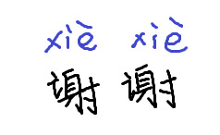
Stay Safe and Healthy
Xie Xie!!!

Slide 73
MORE PRACTICE PROBLEMS
Do it by yourself

Slide 74
Try to solve at your own?

Slide 75
Binomial Theorem
Examples: --- Do it by yourself

Slide 76
Binomial Theorem
Examples: --- Do it by yourself

Slide 77
Examples: --- Do it by yourself

Slide 78
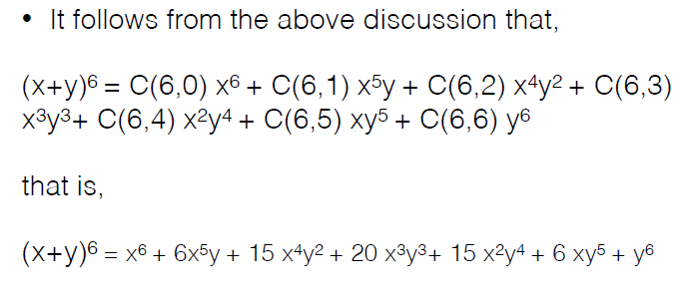
Examples: --- Do it by yourself

Slide 79
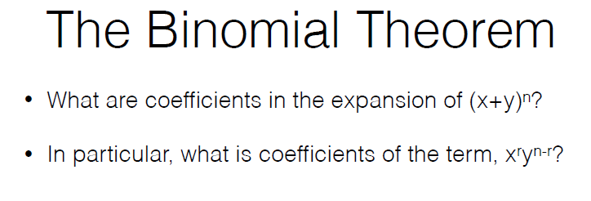
Examples: --- Do it by yourself

Slide 80
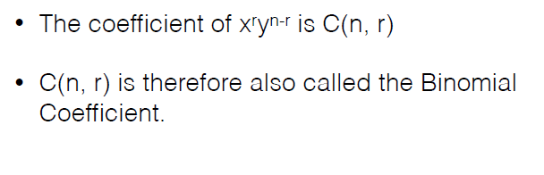
Examples: --- Do it by yourself

Slide 81
Examples: --- Do it by yourself

Slide 82
Corollary 1:
Examples: --- Do it by yourself

Slide 83
Corollary 1:
Examples: --- Do it by yourself

Slide 84
Corollary 2:
Examples: --- Do it by yourself

Slide 85
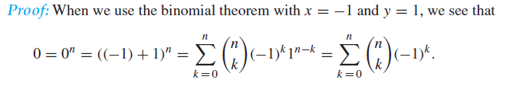
Corollary 2:
Examples: --- Do it by yourself

Slide 86
Corollary 2:
Examples: --- Do it by yourself

Slide 87

Combinations
Examples: --- Do it by yourself

Slide 88
Examples: --- Do it by yourself

Slide 89
